Slide 1



MILITARY COLLEGE OF ELECTRONICS AND MECHANICAL ENGINEERING
FACULTY OF ELECTRONICS
RC DEPT
TO DESIGN AN ACCOUNTS MANAGEMENT SOFTWARE
FOR EME JOURNAL FUND
TO DESIGN AND SIMULATDAR
USING SIMULATION SOFTWARE
DIRECTING STAFF
LT COL ANKIT GUPTA
SYNDICATE:
MEHUL ASHRA

Slide 2
PREVIEW
Aim
Scope
Tech Stack & Dependencies
Frontend Application
Case based inputs
Sample based outputs
Future scope
Conclusion

Slide 3
AIM: TO DESIGN AN ACCOUNTING SOFTWARE TO AUTOMATE THE PROCESS OF EME LEDGER MANAGEMENT

Slide 4
SCOPE
Allow user to add incoming and outgoing payments using a double entry system.
Automate generation of Counter Entries for ledger entries
Display output as tables with options of filtering and sorting
Autonomous generation of balance sheet for monthly transactions

Slide 5
Tech Stack & Dependencies
Python 3.10.0 – Core programming language for backend logic and scripting. Tkinter – Standard Python library for building a responsive and user-friendly graphical interface. MySQL – Robust relational database system for secure and structured data storage. mysql-connector-python – Library enabling seamless connectivity between Python and MySQL. Pillow (PIL) – Python Imaging Library used for handling and displaying images in the application. Standard Libraries – Including `os`, `sys`, and `io` for file handling and system operations.
*All components work together to deliver a reliable, interactive, and efficient ledger management solution.*

Slide 6
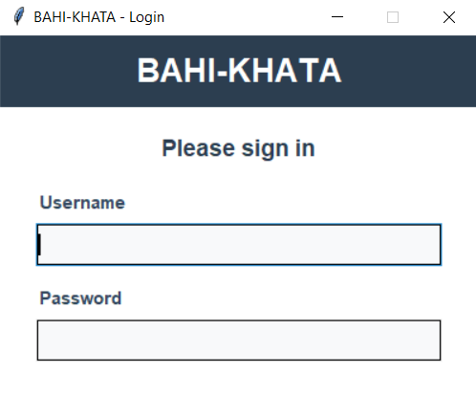
LOGIN PAGE
USER AUTHENTICATION PAGE FOR DIFFERENT ROLES
ADMIN :- Has all permissions from adding and viewing transaction and finally approving them.
ACCOUNTANT :- Has the ability to add and view transactions but requires approval from the admin
VIEWER :- Can only view transactions that have been approved

Slide 7
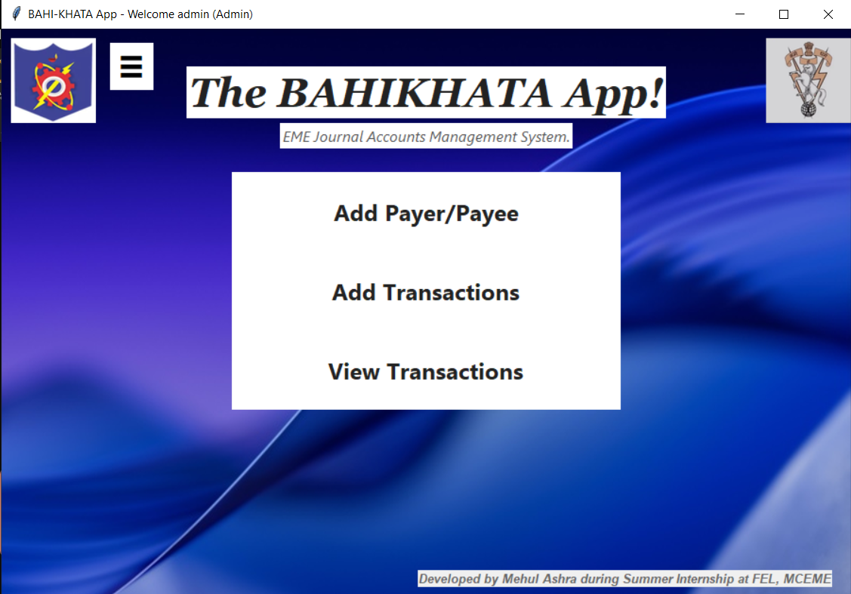
APPLICATION FRONTEND
MAIN MENU

Slide 8
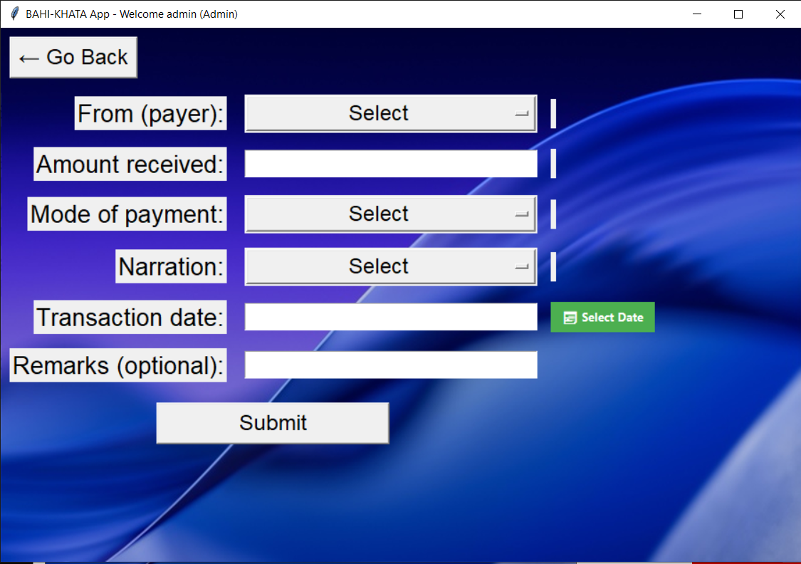
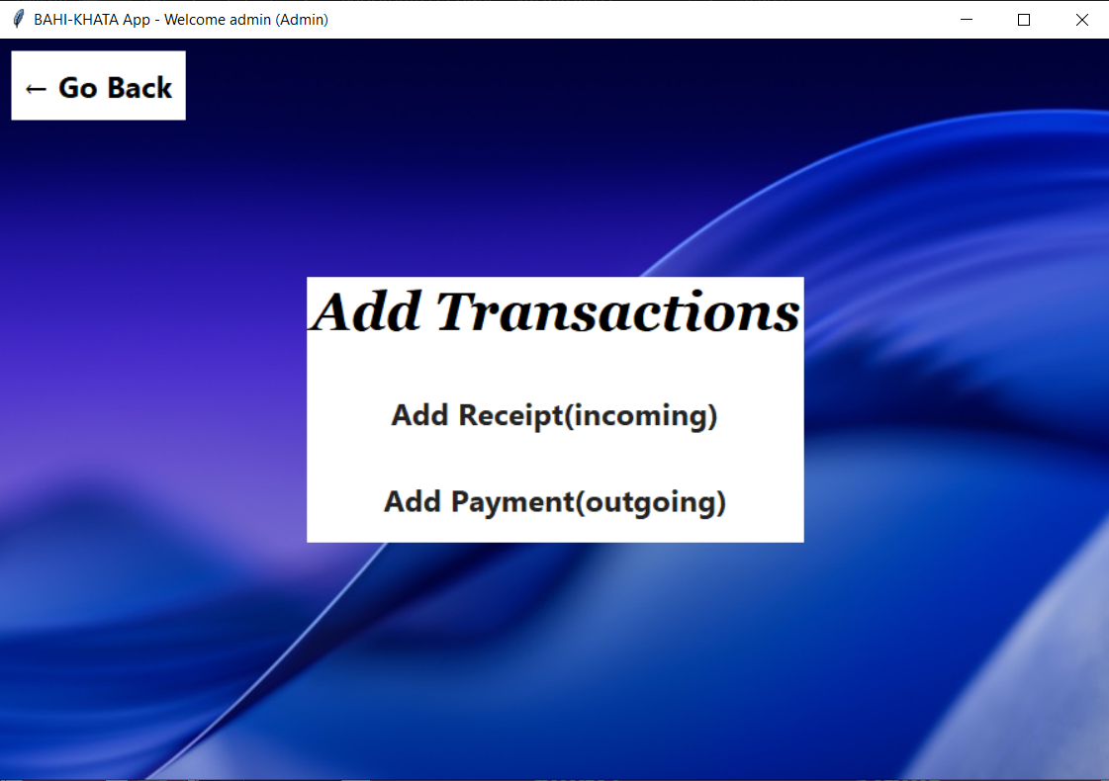
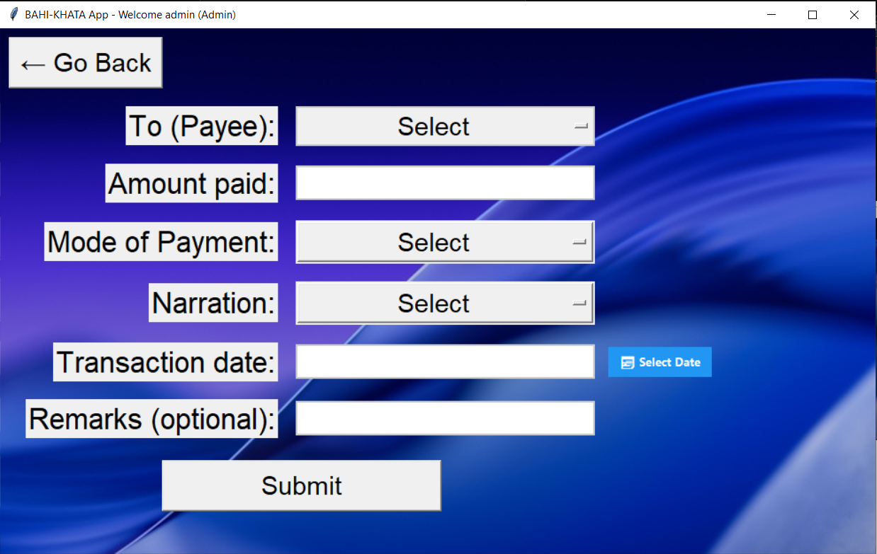
ADDING NEW TRANSACTIONS
INCOMING TRANSACTION
INPUT OFINCOMING/OUTGOING PAYMENT
OUTGOING TRANSACTION

Slide 9
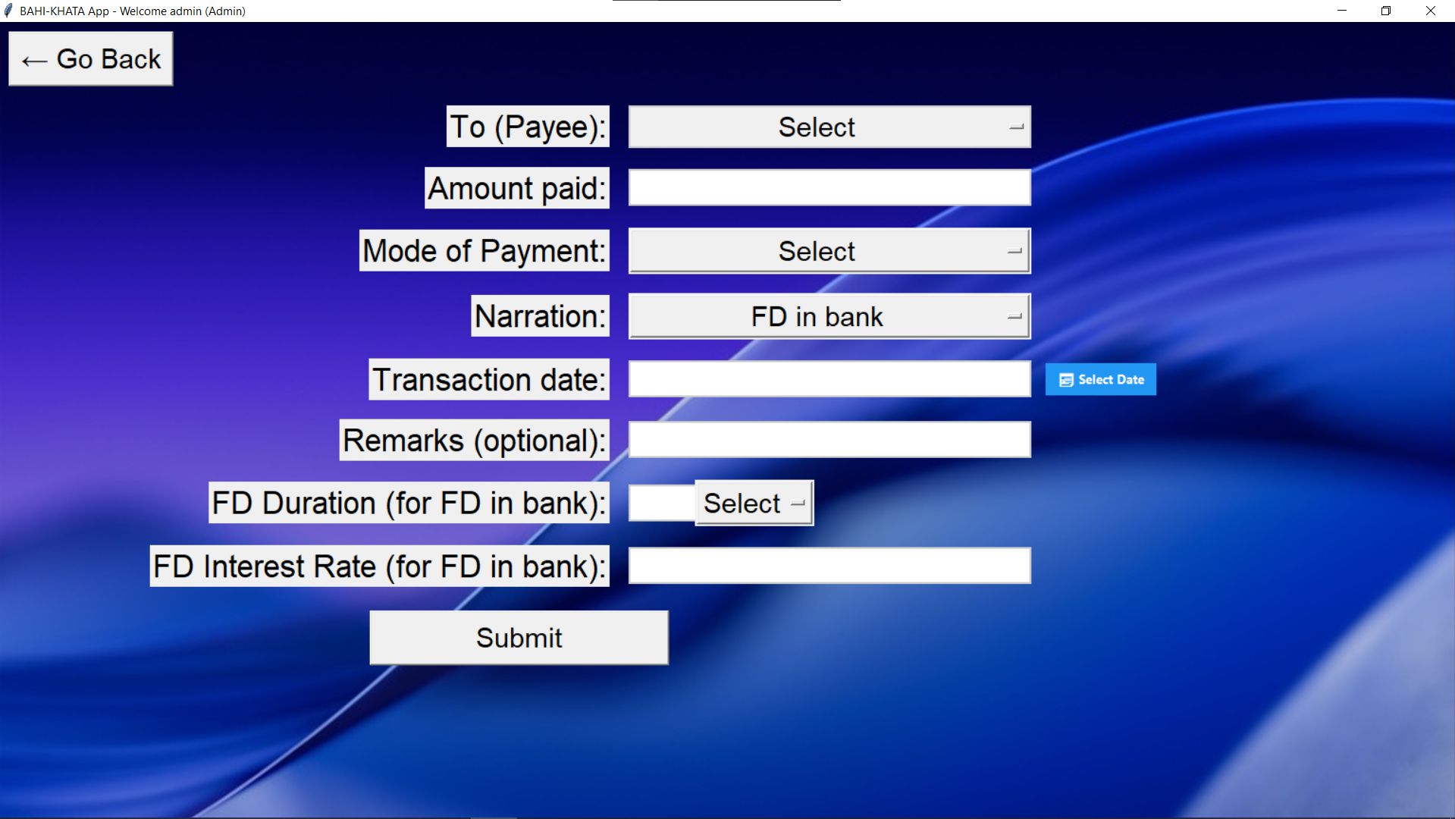
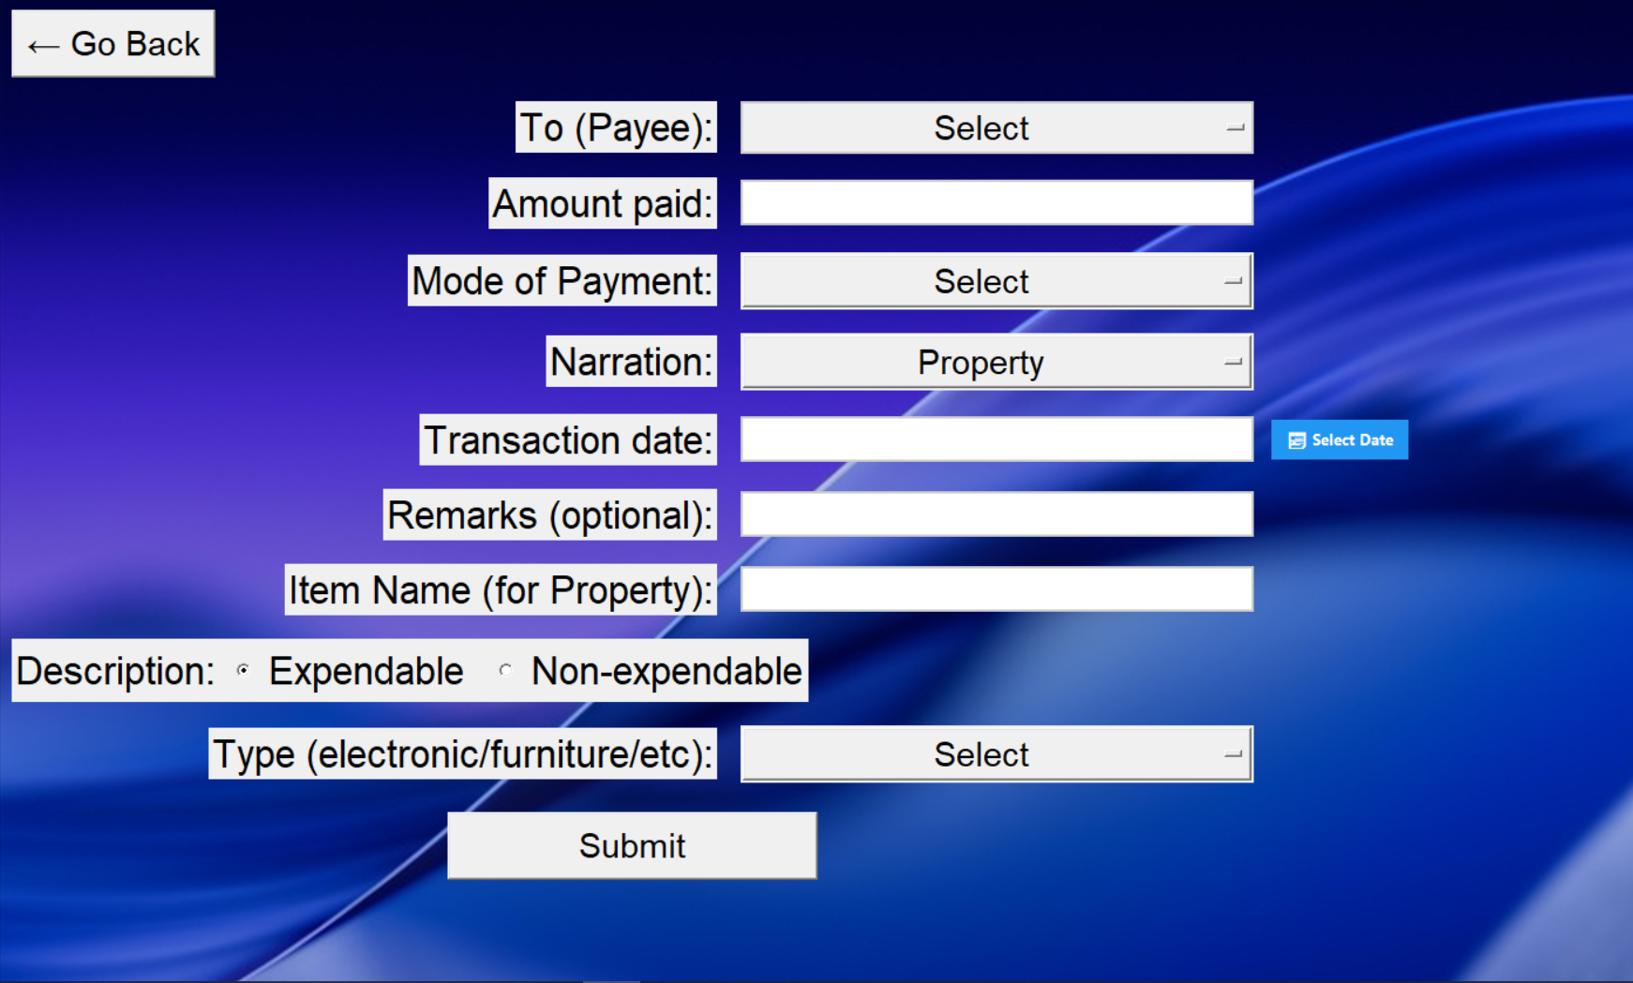
CASE BASED INPUTS
Payment for new fixed deposit
Payment for purchase of new Property

Slide 10
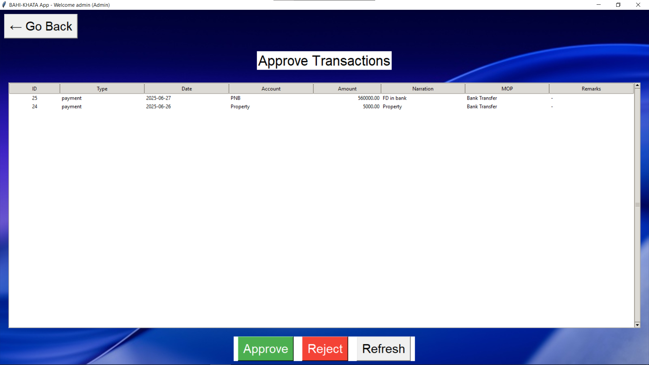
TRANSACTION APPROVAL PAGE

Slide 11
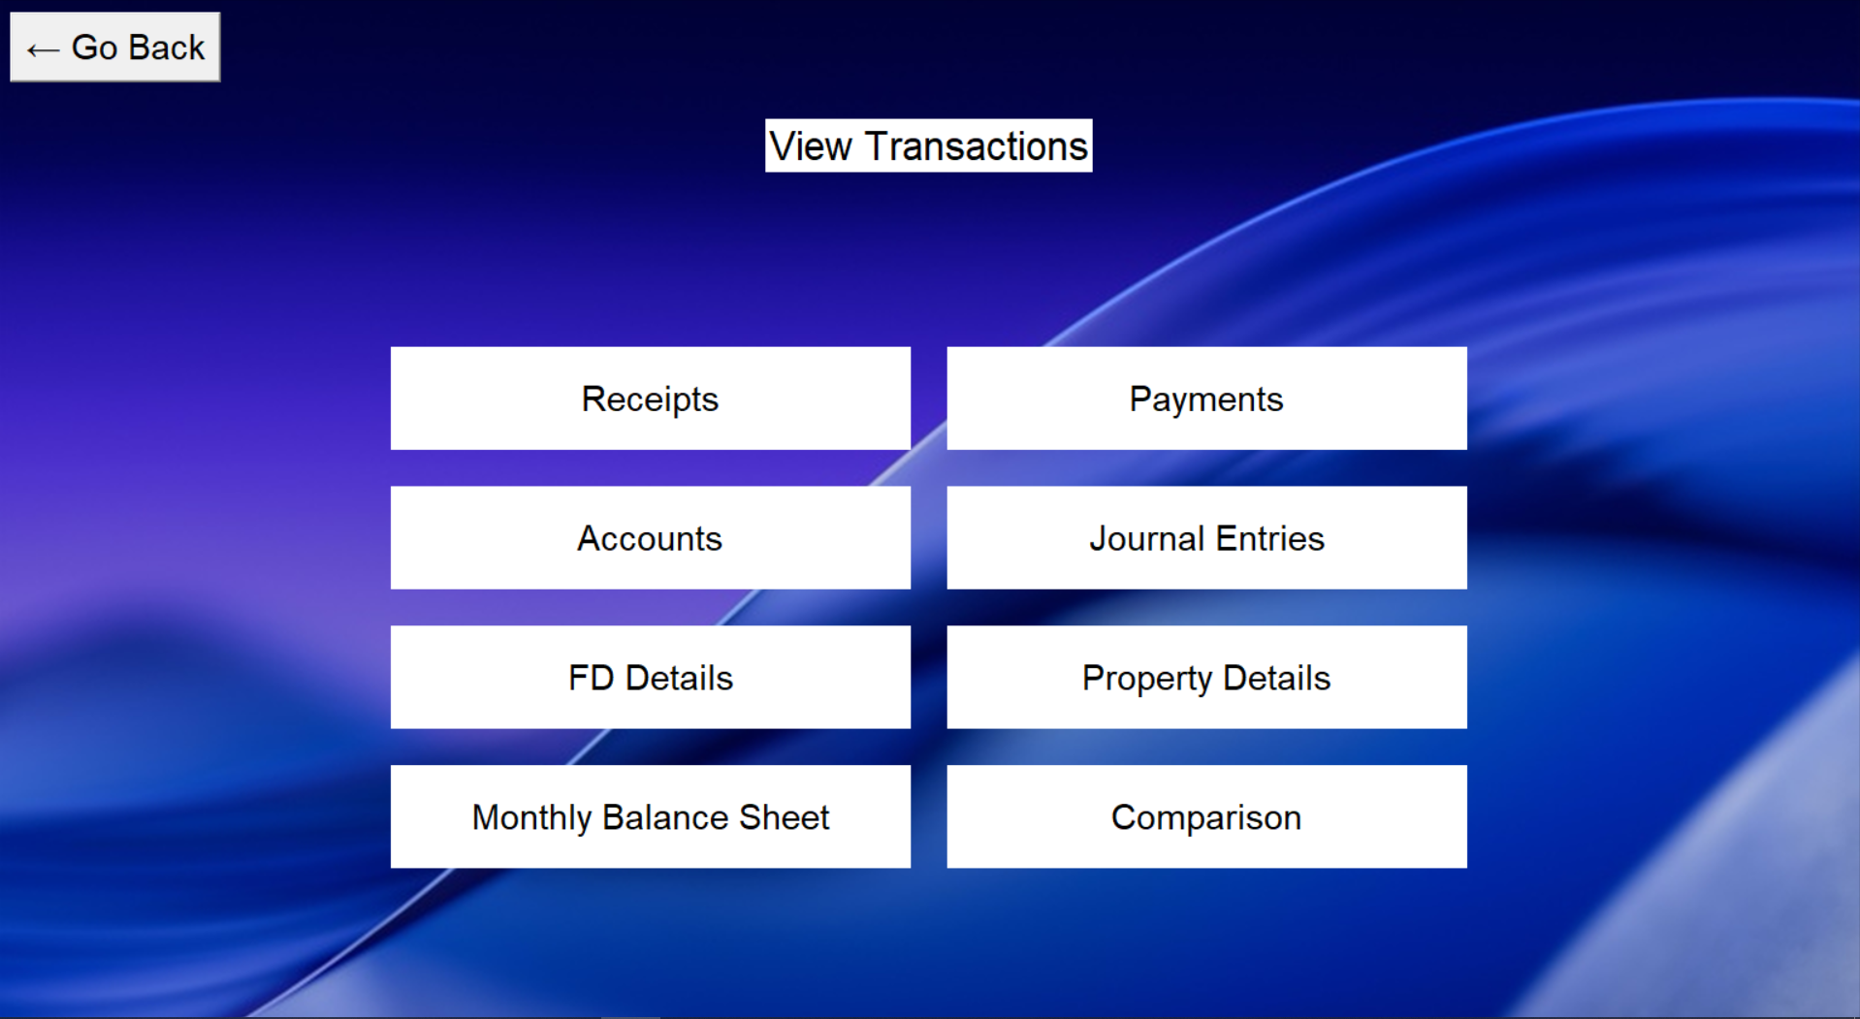
VIEWING DATA IN TABULAR FORM

Slide 12
JOURNAL ENTRIES
Option to export data in excel format for ease of use

Slide 13
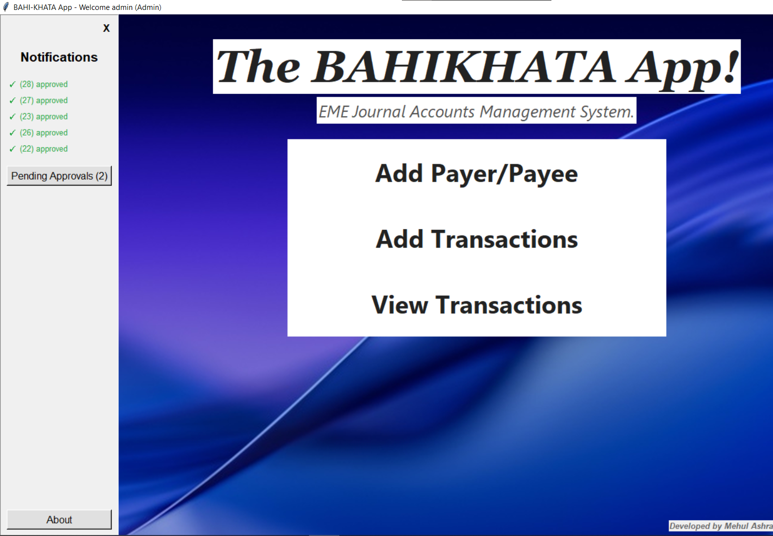
NOTIFICATION SIDEBAR

Slide 14
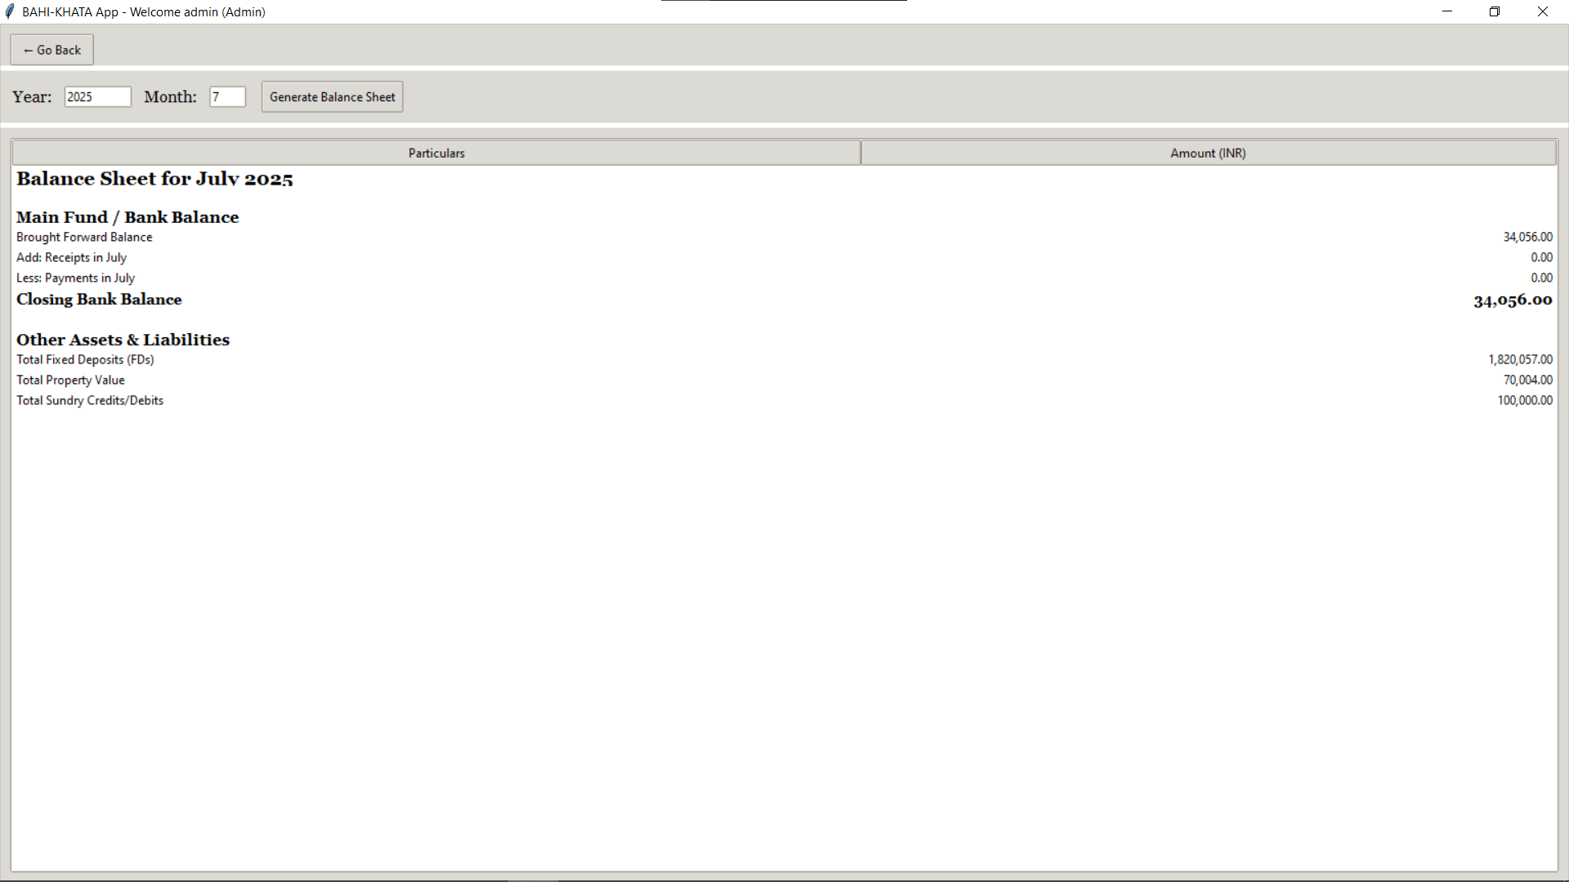
NOTIFICATION SIDEBAR

Slide 15



FUTURE IMPLICATIONS
Addition of a monthly balance sheet feature for regular financial summaries. - DONE
Automatic calculation and carry-forward of balances to the next month. - DONE
Generating a list of defaulters for better tracking of outstanding payments. – DONE
Implementing double-entry tally checks to ensure accurate and balanced records. – DONE

Slide 16
CHALLENGES
WAY AHEAD
THE PROJECT IS FEASIBLE AND CAN BE CAN BE EASILY RUN ON ANY SYSTEM WITHOUT THE NEED OF INTERNET

